Slide 1
The Art of Hacking Yourself
Mr. Joshua Moris

Slide 2
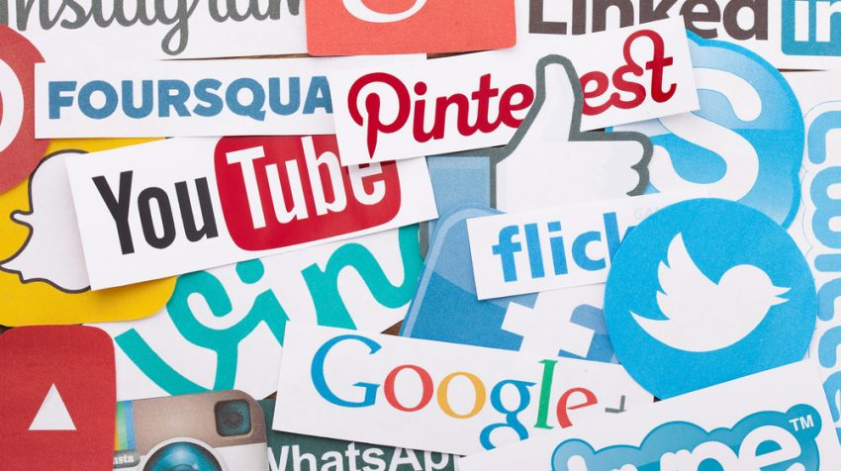
What is Social Media
Definition
Social Media
Forms of electronic communication (as websites for social networking and microblogging) through which users create online communities to share information, ideas, personal messages, and other content.
Origins: 2004 (Social Media, n.d.)

Slide 3
Social Media Statistics
UNITED STATES % of Users
Global (Monthly active users)
76% Facebook
51% Instagram
42% Twitter
25% Pinterest
18% LinkedIn
(Social media Fact Sheet, 2017)
Facebook – 1.87 billion
WhatsApp – 1 billion
Facebook Messenger – 1 billion
Instagram – 600 million
Twitter – 317 million
(Global social media research summary 2017, 2017).

Slide 4
Hacking and Social Media
Definition
Social Media Penetrations
Hacker
Person who illegally gains access.
(Hacker, n.d.)
In terms of social media?
Person has a personal agenda.
Facebook – 160,000 times/day
(Callahan, 2015)
Twitter – 2,500 accounts
(Narang, 2016)
Tumblr – 65 million passwords
(Burgess, 2016)
SnapChat – 4.5 million users
(Gross, 2014)

Slide 5
How is Social Media Used Against You?
Password Guessing
1 in 5 individuals use a “name” and “date” in their password (Ofcom, 2016).
42% of individuals re-use the same password (Ofcom, 2016).
Social Engineering
Email Phishing (Business)
Impersonation

Slide 6
Methods to Protect
Change passwords often.
Use two-step authentication.
Utilize trusted “Wi-Fi” areas.
Manage privacy settings on social networks.

Slide 7
Education
Weakest link an any network?
End users
Social media network policies.
Password requirements do not protect end user (social engineering)
Do not hold authoritative power (adhere to policies)
Parents educate?
Lack of knowledge
Poor habits already formed
Educational institutions called to inform.

Slide 8
Shared Responsibility
Social Networks
End User Research
Educational Institutions
Alter the “mindset”

Slide 9
Topics to Consider Today Kenya – Ushering a New Approach to Cyber
Cyber Crime Laws in Kenya
Destruction of Infrastructure
Cyber Security Education
Educating the leaders of tomorrow
Human / Computer Interaction
New approach
Change “mindset”
The Value of Data

Slide 10
Asante Sana & Thank You
From your friends at Clarke University

Slide 11
References
Maina, A. (2017, February 15). 20 Popular Social Media Sites Right Now. Retrieved from https://smallbiztrends.com/2016/05/popular-social-media-sites.html
Deschatres, S. (2014, July 08). Social engineering: Attacking the weakest link in the security shain. Retrieved from Symantec: https://www.symantec.com/connect/blogs/social-engineering-attacking-weakest-link-security-chain
Gragg, D. (2002, December). A Multi-Level Defense Against Social Engineering. Retrieved from SANS: https://www.sans.org/reading-room/whitepapers/engineering/multi-level-defense-social-engineering-920
Gross, D. (2014, January 1). Millions of accounts compromised in Snapchat hack. Retrieved from CNN: http://www.cnn.com/2014/01/01/tech/social-media/snapchat-hack/
Hacking. (n.d.). Retrieved from Techopedia.com: https://www.techopedia.com/definition/26361/hacking
Social Media. (n.d.). Retrieved from Merriam-Webster: https://www.merriam-webster.com/dictionary/social%20media
Social Media Fact Sheet. (2017, January 12). Retrieved from Pew Research Center: http://www.pewinternet.org/fact-sheet/social-media/
Symantec. (2017). 2017 Internet Security Threat Report. Retrieved from Symantec: https://www.symantec.com/security-center/threat-report
Wisniewski, C. (2016, August 18). NIST’s new password rules – what you need to know. Retrieved from Naked Security: https://nakedsecurity.sophos.com/2016/08/18/nists-new-password-rules-what-you-need-to-know/

Slide 12
References (cont’d)
Harrison, V., & Pagliery, J. (2015, April 14). Nearly 1 million new malware threats released every day. Retrieved from CNN: http://money.cnn.com/2015/04/14/technology/security/cyber-attack-hacks-security/
Hern, A. (2016, May 31). More than 65m Tumblr emails for sale on the darknet. Retrieved from TheGuardian: https://www.theguardian.com/technology/2016/may/31/tumblr-emails-for-sale-darknet-65-million-hack-passwords
Hern, A. (2017, March 15). Twitter accounts tweet swastikas and pro-Erdoğan support in massive hack. Retrieved from The Guardian: https://www.theguardian.com/technology/2017/mar/15/twitter-turkey-accounts-hack-tweet-swastikas-pro-erdogan
Jaccarino, M. (2011, October 29). Facebook hack attacks strike 600,000 times per day, security firm reports . Retrieved from Daily News: http://www.nydailynews.com/news/national/facebook-hack-attacks-strike-600k-times-day-article-1.968681
Krazit, T. (2016, June 20). Employees are the weakest link in computer security. Retrieved from Fortune: http://fortune.com/2016/06/20/employees-computer-security/
Narang, S. (2016, May 23). Hacked Twitter accounts are posting links to adult dating and sex personals. Retrieved from Symantec Corporation: https://www.symantec.com/connect/blogs/hacked-twitter-accounts-are-posting-links-adult-dating-and-sex-personals
Ofcom. (2016, August). Internet-use-and-attitudes-2016.pdf. Retrieved from www.ofcom.org: https://www.ofcom.org.uk/__data/assets/pdf_file/0023/63950/Internet-use-and-attitudes-2016.pdf

Slide 13
References (cont’d)
Passrequirements.com. (n.d.). Password requirements for facebook | passrequirements.com. Retrieved from Passrequirements.com: http://passrequirements.com/passwordrequirements/facebook
Perez, S. (2011, October 28). Facebook sees 600,000 compromised logins per day. Retrieved from TechCrunch.com: https://techcrunch.com/2011/10/28/facebook-sees-600000-comprised-logins-per-day/
Roeder, L. (2016, September 18). Facebook scams to avoid: "I need money". Retrieved from Lifewire.com: https://www.lifewire.com/i-need-money-facebook-scam-2654773
Schneider, L. (2017, February 15). Leading information security organizations. The Balance. Retrieved from https://www.thebalance.com/leading-information-security-organizations-2071545
Shin, L. (2017, January 8). Be prepared: the top 'social engineering' scams of 2017. Retrieved from Forbes.com: https://www.forbes.com/sites/laurashin/2017/01/04/be-prepared-the-top-social-engineering-scams-of-2017/#311de4357fec
Social Engineer, Inc. (2014, April 28). The social engineering infographic - security through education. Retrieved from Social-engineer.org: http://www.social-engineer.org/social-engineering/social-engineering-infographic/
Social Engineer, Inc. (n.d.). Social engineering defined - security through education. Retrieved from Social-engineer.org: http://www.social-engineer.org/framework/general-discussion/social-engineering-defined/

